Slide 1
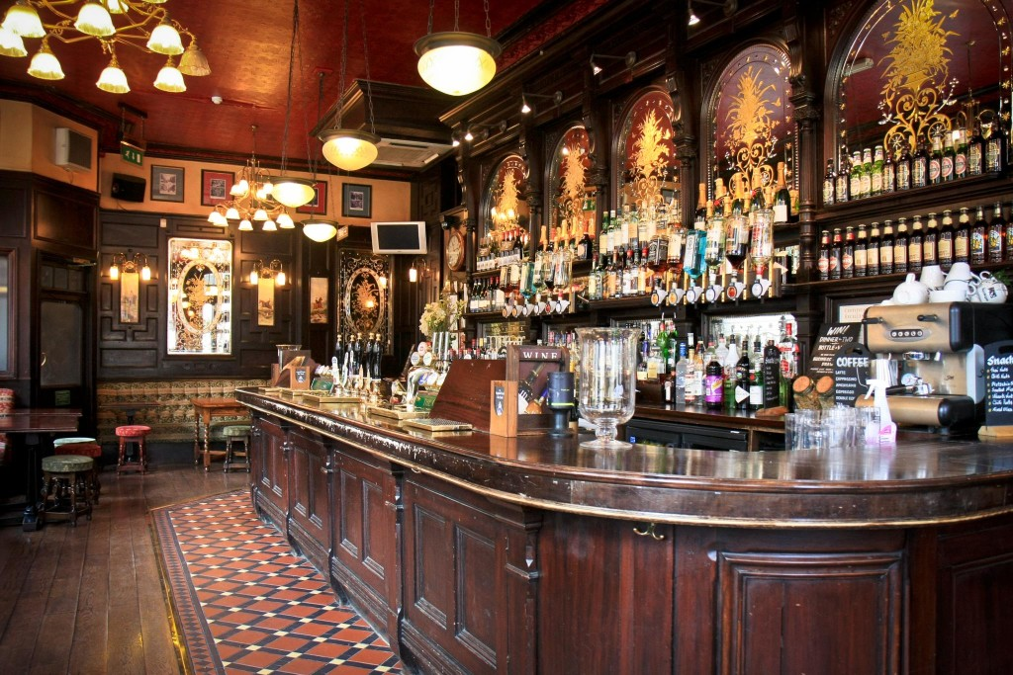

SQL CHALLENGE – 5
PUB PRICING ANALYSIS
Presented By: SUMANTH KUMAR

Slide 2
Introduction
As a Pricing Analyst working for a pub chain called 'Pubs "R" Us’
I have been tasked with analyzing the drinks prices and sales to gain a greater insight into how the pubs in your chain are performing.
This case study by Steel Data has 4 Tables:
Pubs
Beverages
Ratings
Sales

Slide 3
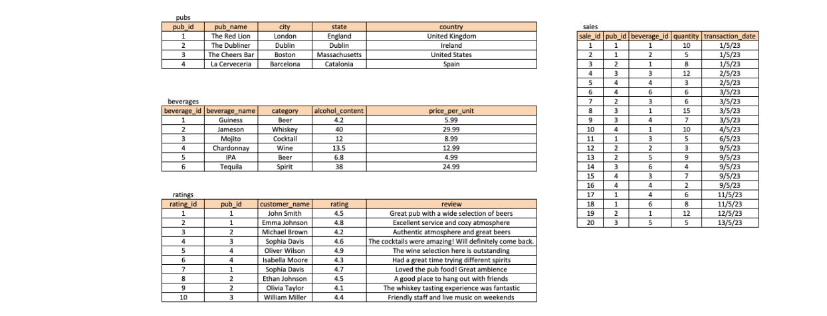
TTABLES

Slide 4
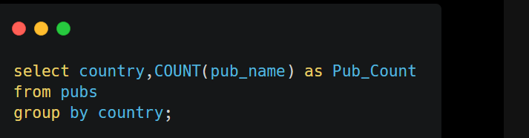
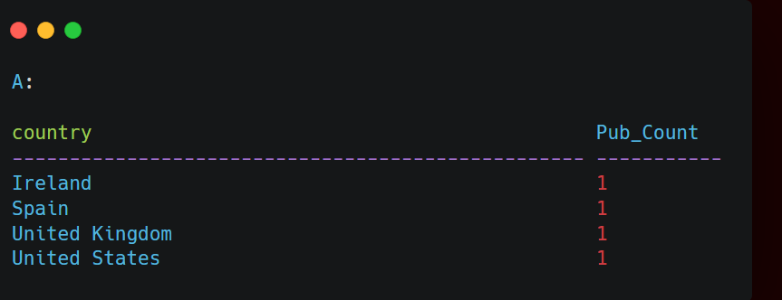
--1. How many pubs are located in each country?

Slide 5
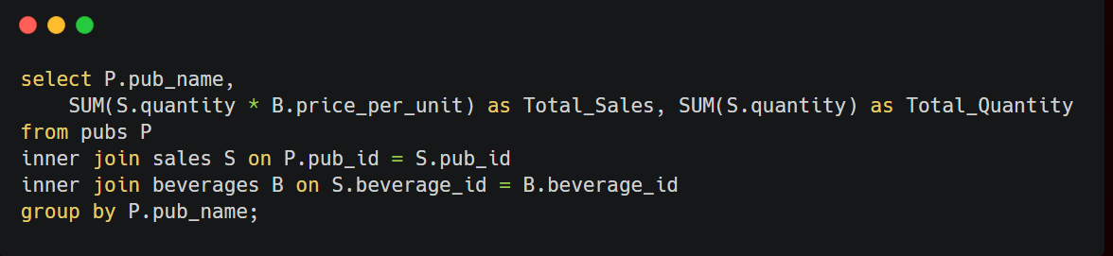
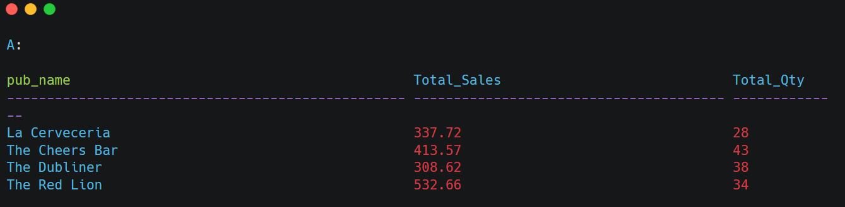
--2. What is the total sales amount for each pub, including the beverage price and quantity sold?

Slide 6
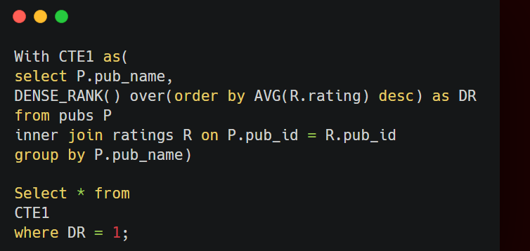
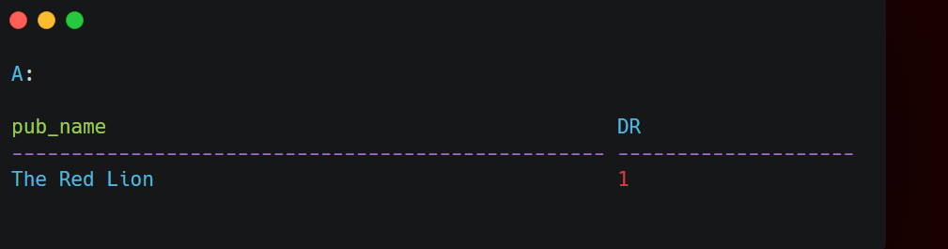
--3. Which pub has the highest average rating?

Slide 7
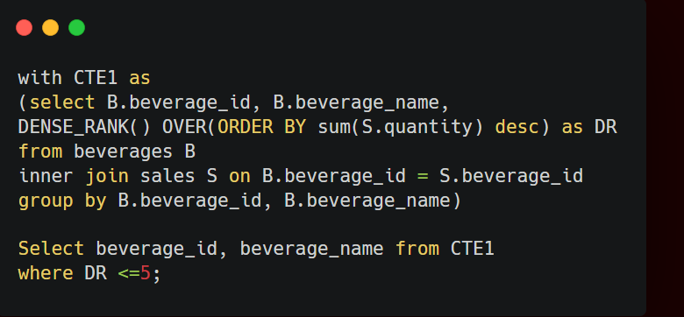
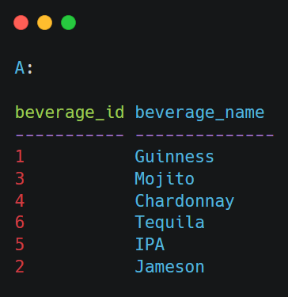
--4. What are the top 5 beverages by sales quantity across all pubs?

Slide 8
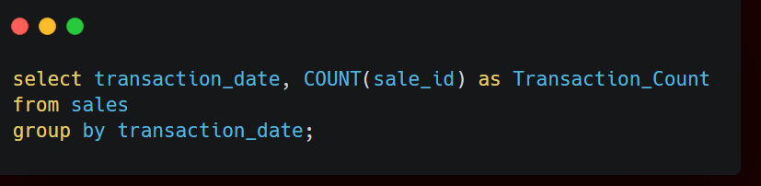
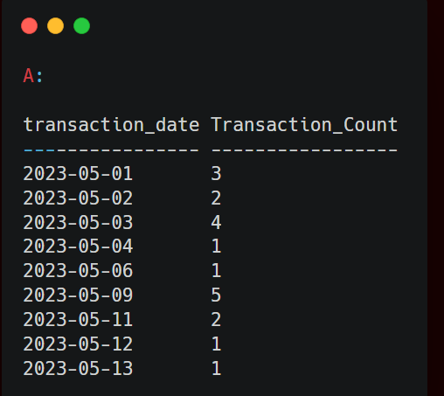
--5. How many sales transactions occurred on each date?

Slide 9
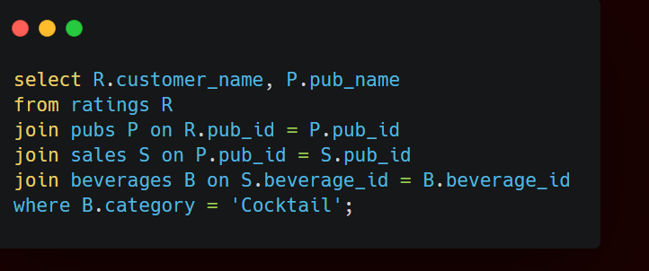
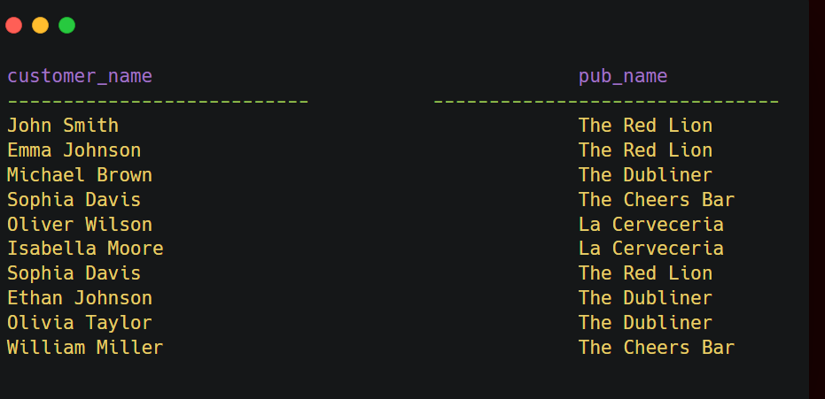
--6. Find the name of someone that had cocktails and which pub they had it in?

Slide 10
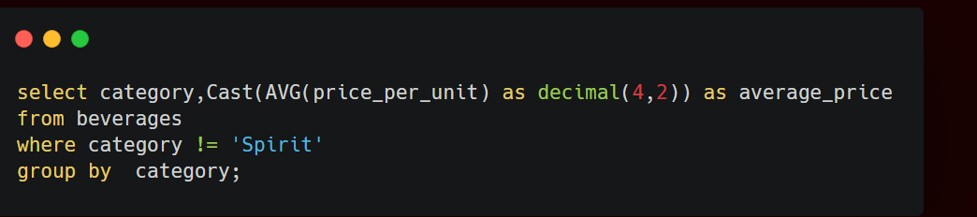
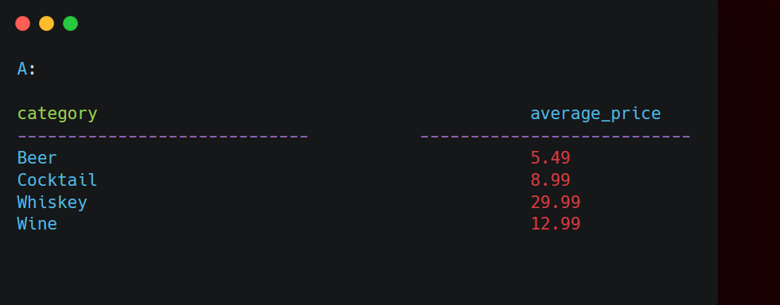
--7. What is the average price per unit for each category of beverages, excluding the category 'Spirit'?

Slide 11
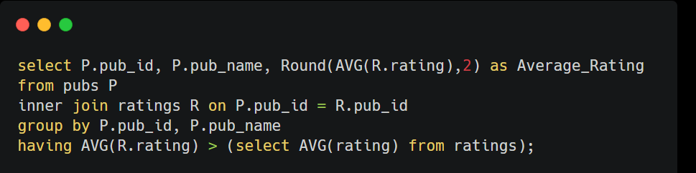
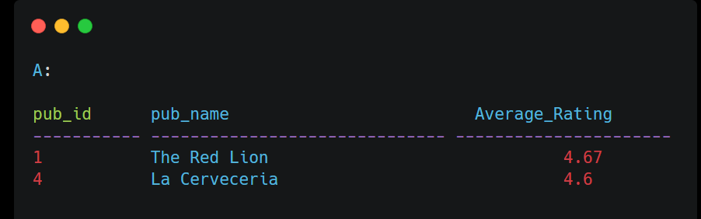
--8. Which pubs have a rating higher than the average rating of all pubs?

Slide 12
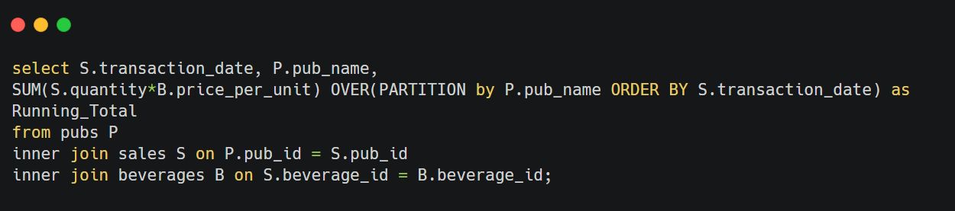
--9. What is the running total of sales amount for each pub, ordered by the transaction date?

Slide 13
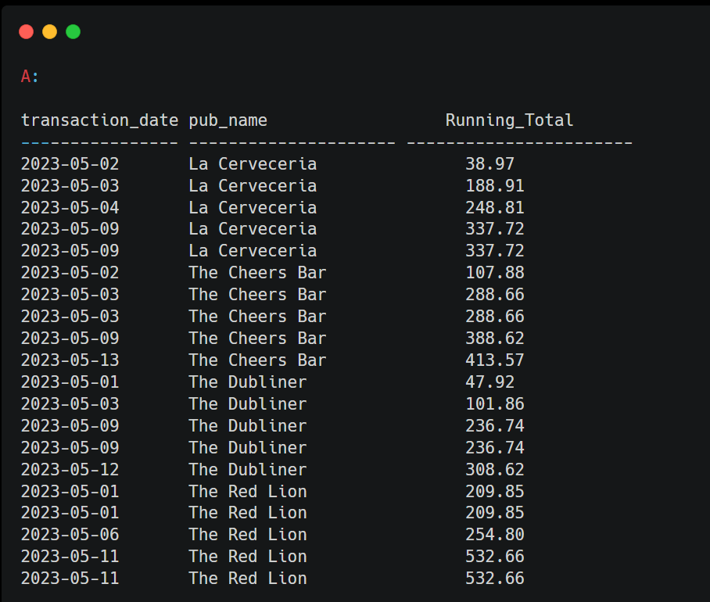
Output:

Slide 14
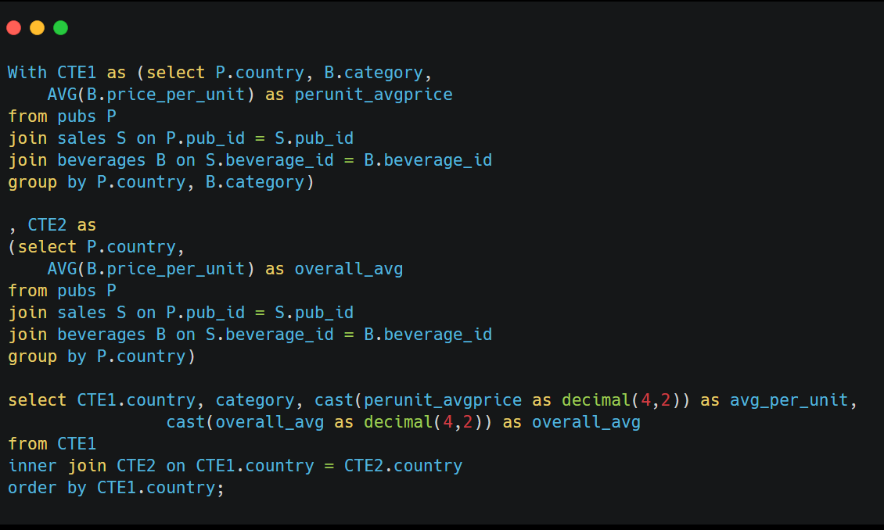
--10. For each country, what is the average price per unit of beverages in each category, and what is the overall average price per unit of beverages across all categories?

Slide 15
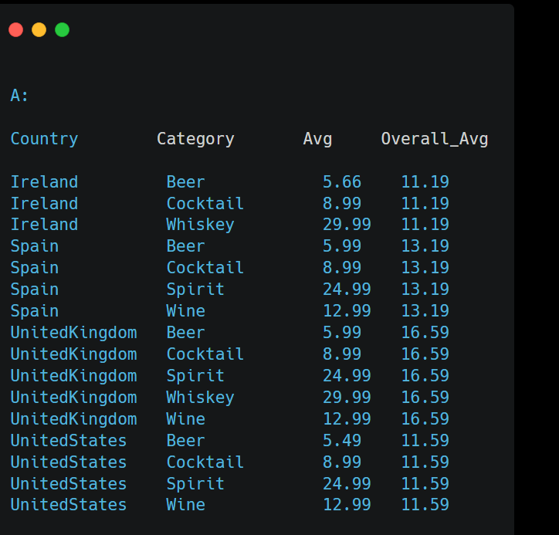
Output:

Slide 16
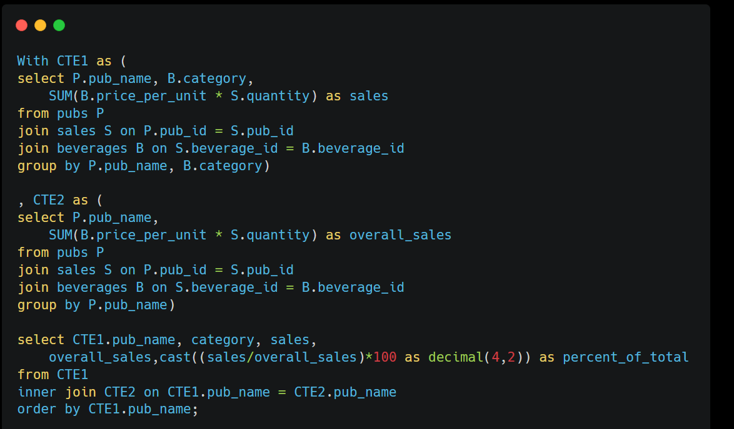
--11. For each pub, what is the percentage contribution of each category of beverages to the total sales amount,
--and what is the pub's overall sales amount?

Slide 17
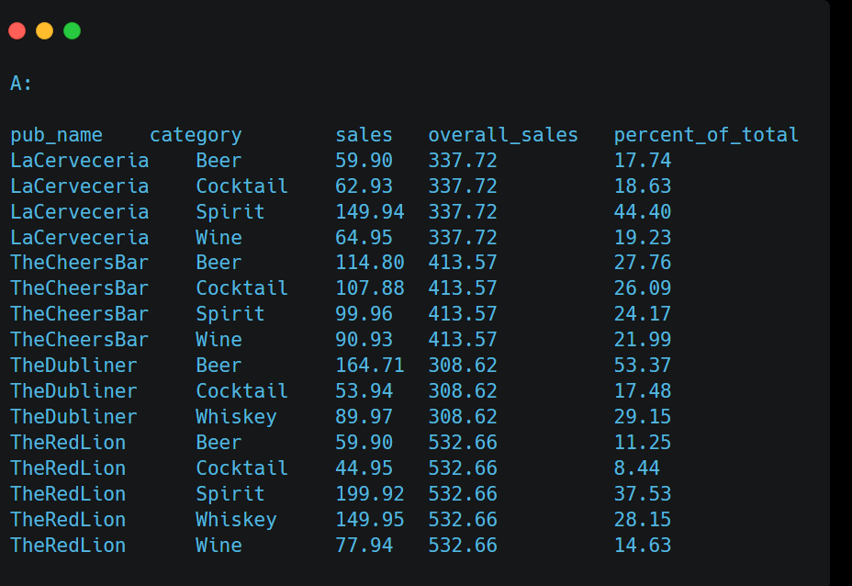
Output :

